Slide 1
Functions
For Junior Knights
By Rachael Sera

Slide 2
Terminology
Function
Method
Notes:
Functionally (see what I did there?), these are the same thing. What we’ll be doing today are “functions,” as “methods” as associated with “objects.”

Slide 3
Math Functions
y = 2x + 5
f(x) = 3x + 2
Notes:
These functions have input and output. You can input various values for x and get various outputs of y, or f(x).

Slide 4

Defining Functions def name():
def
Tell the computer it’s a function by using the “def” keyword
name
Give your function a name
:
End the line with a semicolon
( )
Put parentheses after the name
Notes:
Frequently, function names involve verbs because functions perform actions. E.g. getNode, findNum, binarySearch.

Slide 5
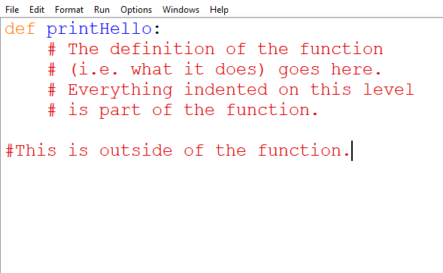
function definition Syntax

Slide 6
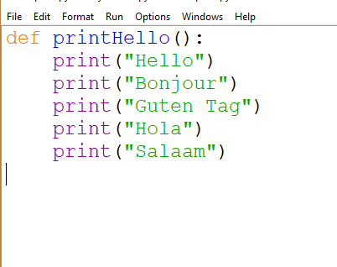
Defining the Function
This function prints hello in several languages

Slide 7
Calling Functions name():
name
Type the function’s name
( )
Put parentheses after the name

Slide 8
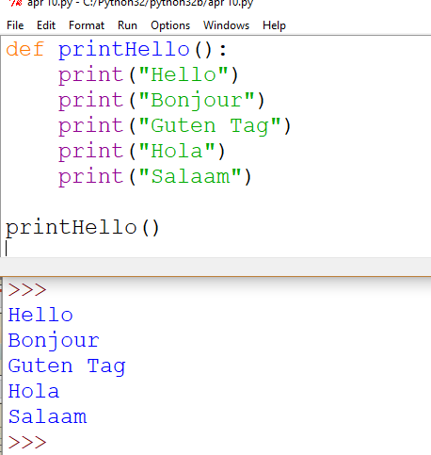
Calling The Function
Notes:
We’re made the function, now let’s actually use it! Note: You must call a function *after* it is defined. The call must come below in the code than the definition.

Slide 9
Motivation for Functions
Repeat an action in multiple places
Update code only once
Makes code easier to read
Notes:
Say we want to add more languages to the printHello example. For those of you who like to do all your assignments in 1 file, you can write your functions in 1 file, but only call 1 at a time and then you’ll only have one problem’s IO to do with each run

Slide 10
Return Values
Void functions
Value-returning functions
Don’t return values
Return values
Notes:
Void functions don’t return values
Non-void functions “return” values
After the function completes, it “becomes” the return value
Store that value in a variable

Slide 11
Returning Values
After the function completes, it becomes the return value
Store that value in a variable. “Capture” the value.
Notes:
We’ve been using functions that return values all semester. input() and len() and random.randint() are some examples.

Slide 12
Return Values return var
return
Use the “return” keyword to denote the return value
Literal
Return a literal value (e.g. 5, “dog”, 3.14)
Variable
Or return a variable that stores the data to be returned
Notes:
Frequently, function names involve verbs because functions perform actions. E.g. getNode, findNum, binarySearch.

Slide 13
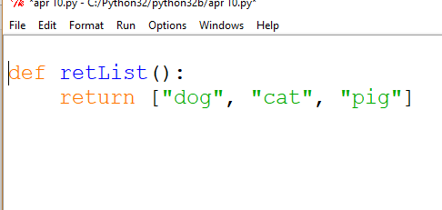
Returning a List

Slide 14
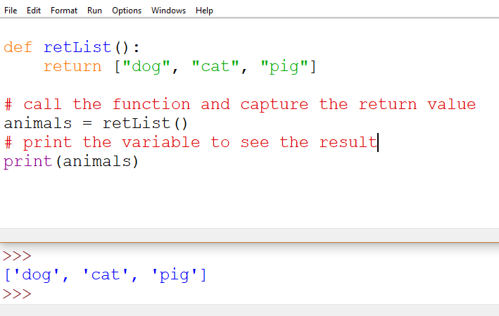
Calling the function and Storing the return value

Slide 15
Parameters
Parameters
Arguments
Notes:
Parameters is what we call what inside the () when you’re defining the function and arguments are what we pass to the function when we call it

Slide 16
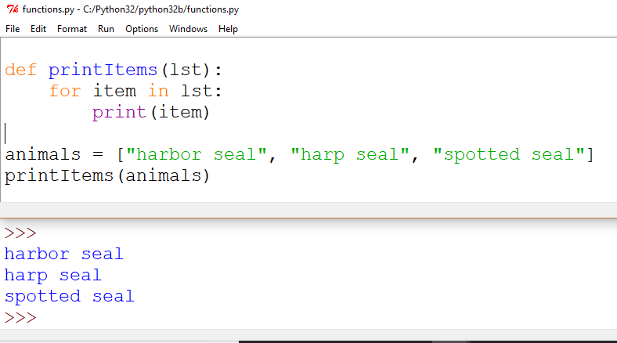
Printing Items in a List
Here’s an alternative way to iterate through a list. Instead of finding the length of the list and going through that length.
Make a for-loop that will put in the variable “item” each element in the list.

Slide 17
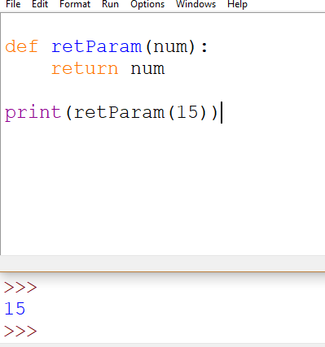
Defining Parameters

Slide 18
Math Functions
y = 2x + 5
f(x) = 3x + 2
Notes:
These functions have input and output. You can input various values for x and get various outputs of y, or f(x).

Slide 19
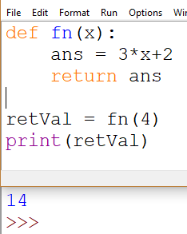
f(x)=3*x+2
We can write the previous mathematical function as a Python function.
We define the function called “fn”
It takes an argument of “x”, which will be the number we multiply by 3
We “return” the output, which is the answer after calculating the math
Last, we call the function and capture the return value
Then print the value to see our work

Slide 20
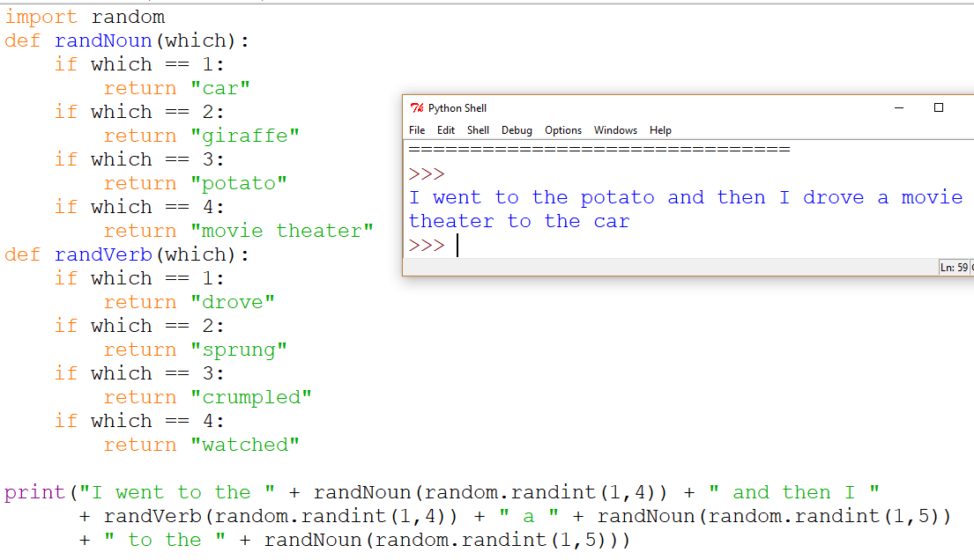
Mad Libs with Functions

